Slide 1
SuperPower Vision Group Team Training
First Training
Linux Shell, CMake, STL and git
Jiawei Liu => jaway.liu@gmail.com
2019/9/29

Slide 2
Today, you’ll learn:
How to write Linux command line code.
How to use CMake to build cross-platform C++ projects.
How to use basic STL tools to boost C++ coding efficiency(or say good bye to C++ ever)
How to use git & GitHub for group work, code communication and …

Slide 3
Linux Shell
/01

Slide 4
What’s an OS?
OS Kernel
User Interface
Maintain the system and work for users.
Bridge between u and OS
i.g: Linux kernel, NT kernel.
Shell, Windows cmd…
If you want to write ur own OS or make some low level optimizations.
Now, we just want to use it. SO we need to learn some SHELL stuff,

Slide 5
Modern OS = Kernel + Interface(CLI + GUI)
CLI in Linux:
Many many kinds of shells := bash, sh, zsh …
Linux Kernel
GUI in Linux:
GNOME, KDE …
CLI(shell): zsh
GUI: GNOME

Slide 6
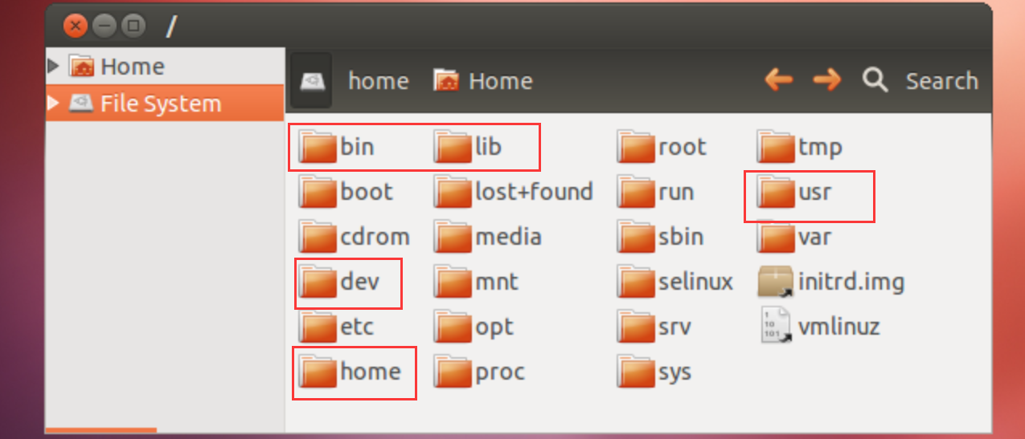
File System Directories
https://www.howtogeek.com/117435/htg-explains-the-linux-directory-structure-explained/

Slide 7
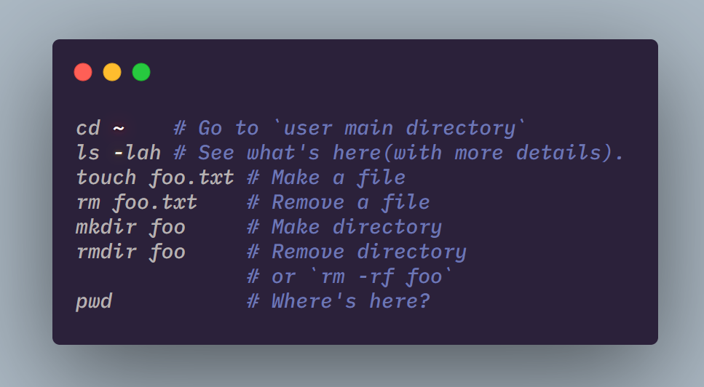
Get hands dirty now

Slide 8
CMake
/02

Slide 9
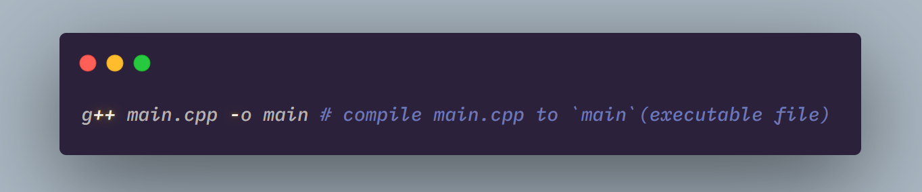
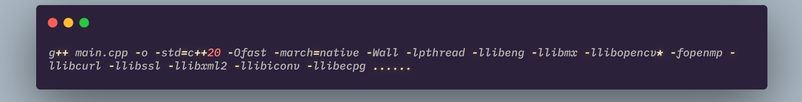
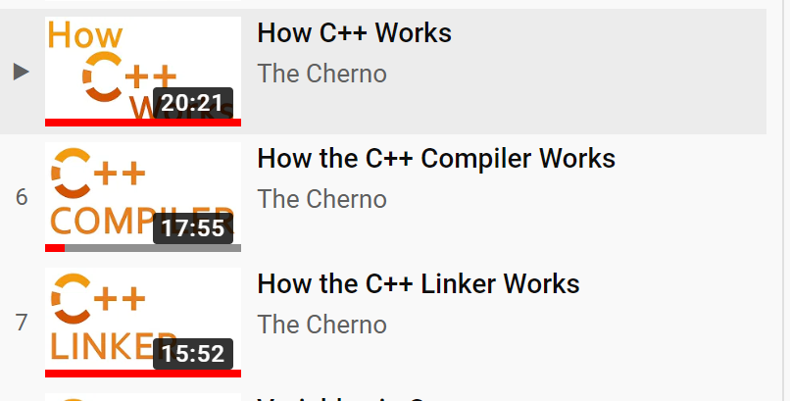
CMake Basic
This is ok if you don’t need any dependency.
What if we want use a library?
How to manage the libraries in a common way?
CMake is the answer!
To understand compiling and linking:
https://www.youtube.com/watch?v=SfGuIVzE_Os&list=PLlrATfBNZ98dudnM48yfGUldqGD0S4FFb&index=5

Slide 10
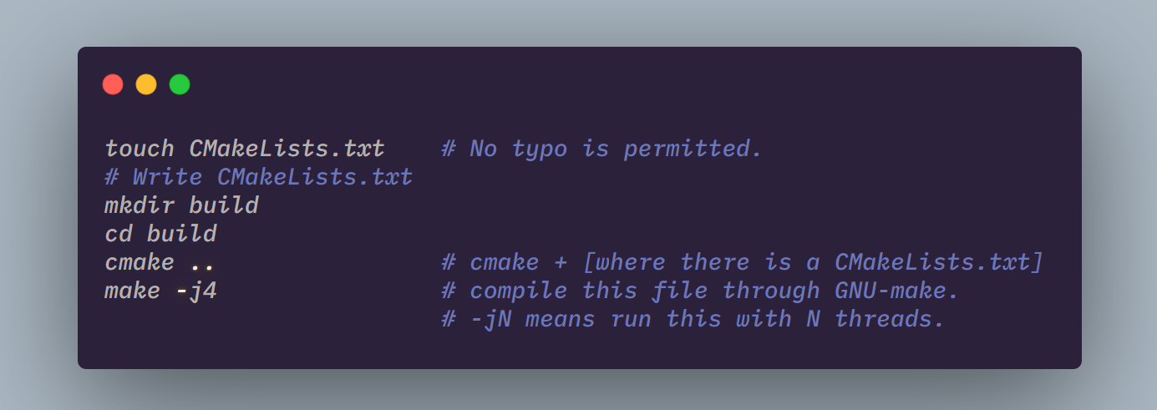
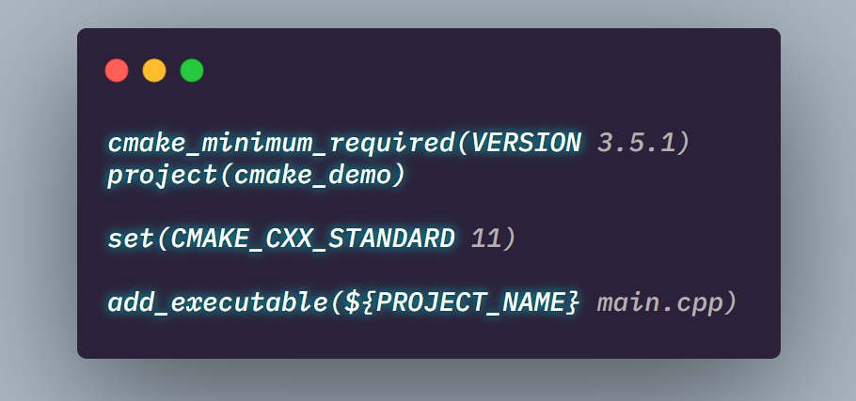
Use CMake

Slide 11
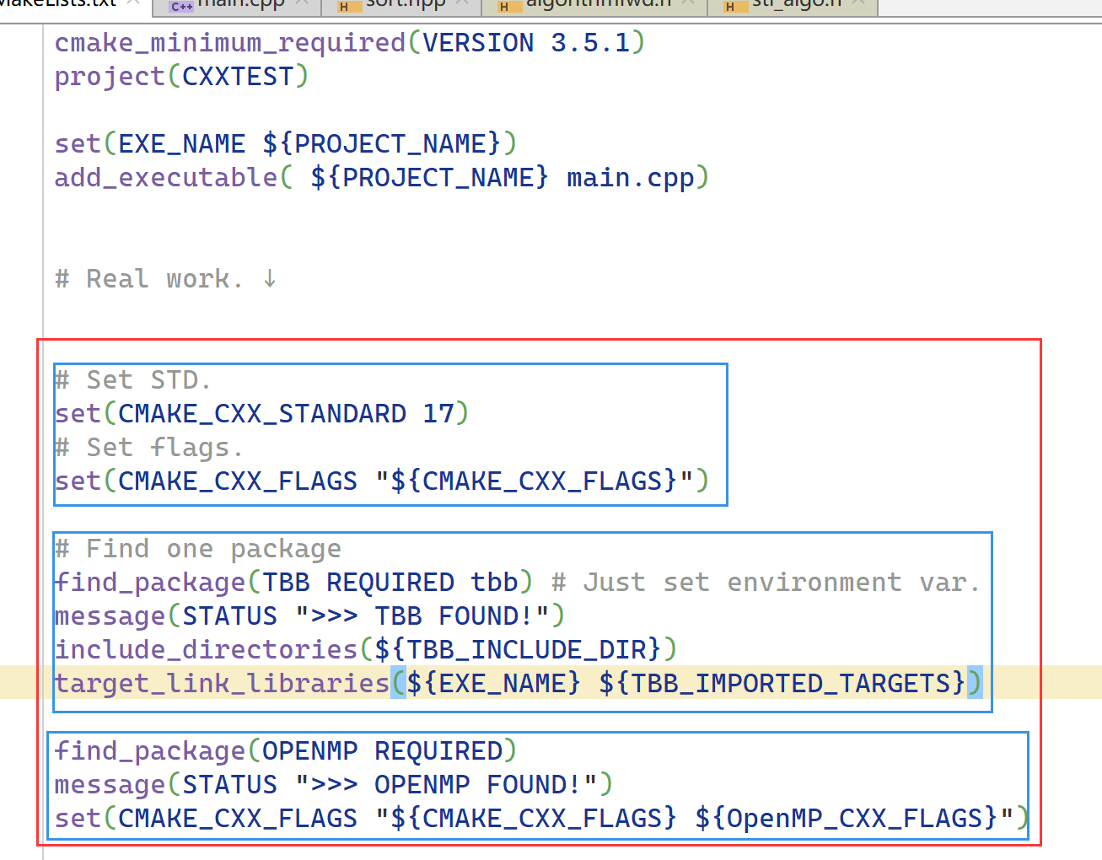
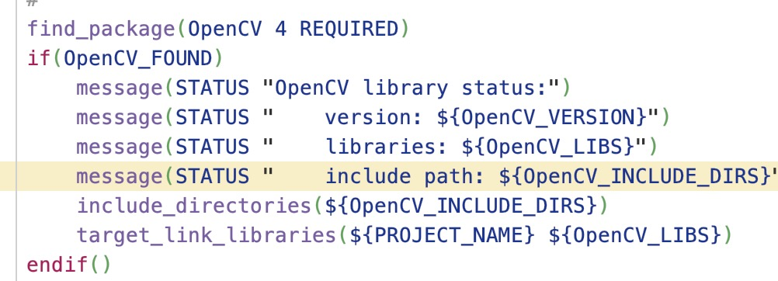
More features

Slide 12
We also use CMake to build LIBRARIES
Let’s try to build GTEST:
https://github.com/google/googletest

Slide 13
STL
/03

Slide 14
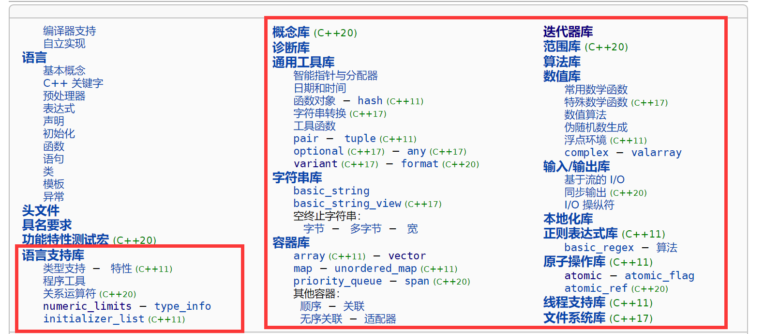
See what’s there and always ref.
https://zh.cppreference.com/w/cpp

Slide 15
Big Idea When Programming
When u are not sure about sth., SEEK FOR REFERENCE.(people, network …), just do not try to execute your code to identify your assumption.
Make enough tests if possible(run debug mode with assert).
For green hands using Python => Running is OK
For grandpa who has been using C++ for 40 years => I don’t C++
Compile error
Linking error
Runtime error: stack overflow, segmentation fault or worse:
PROCESS FINISHED WITH EXIT CODE XXX(which is not 0)
If you don’t care, one day it will pay you a disaster …

Slide 16
STL: Container & Algorithm
std::vector<T>
push_back
T
T
T
T
T
T
T
T
T
std::deque<T>
push_back
T
T
T
T
T
T
T
T
push_front
T
T
T
T
T
T
T
T

Slide 17
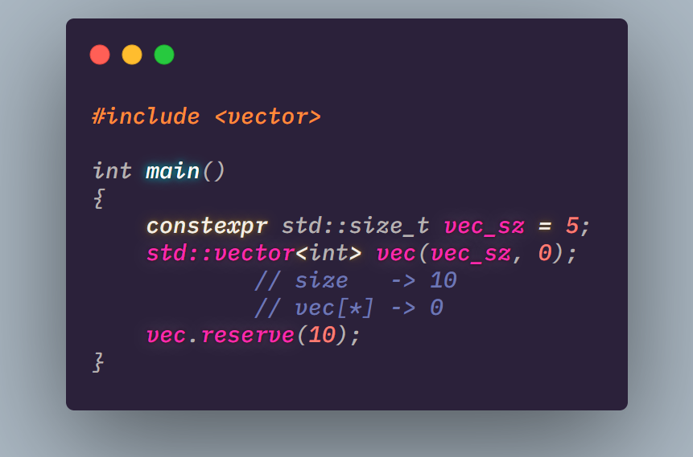
Try to reserve
value
T
T
T
T
T
memory
T
T
T
T
T
value
T
T
T
T
T
memory
T
T
T
T
T
T
T
T
T
T

Slide 18
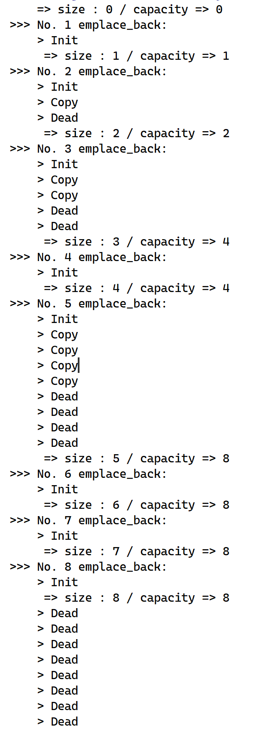
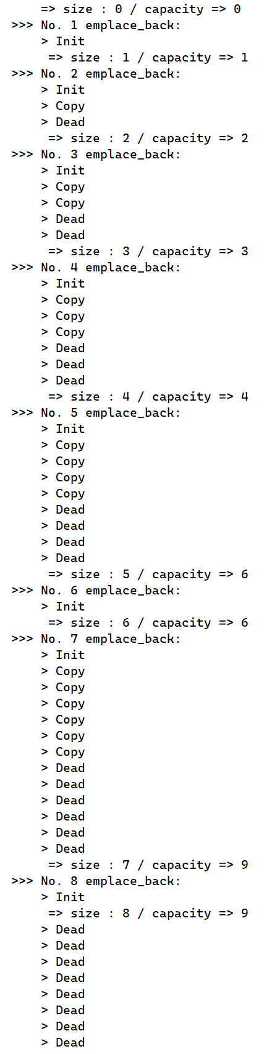
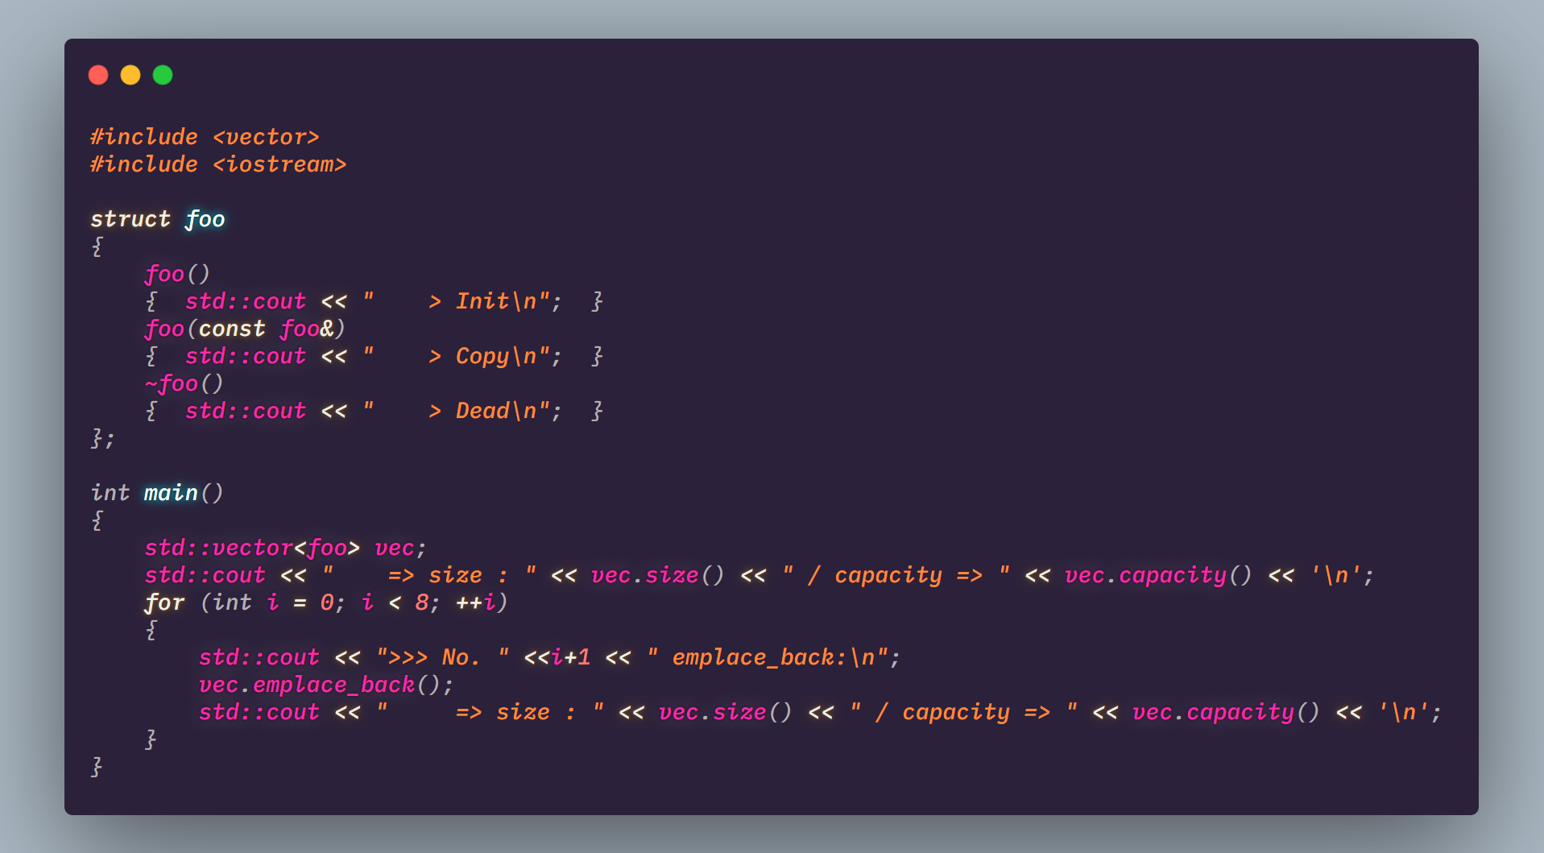
What is push_back doing?
GCC => 2x
MSVC => 1.5x

Slide 19
Conclusion
Use STL containers, they are well implemented.
If you only need `push_back` => std::vector.
If you need `push_front` => std::deque(as a list).
Try `reserve` if possible.
As to other containers … My suggestion is that you’d better ignore them.

Slide 20
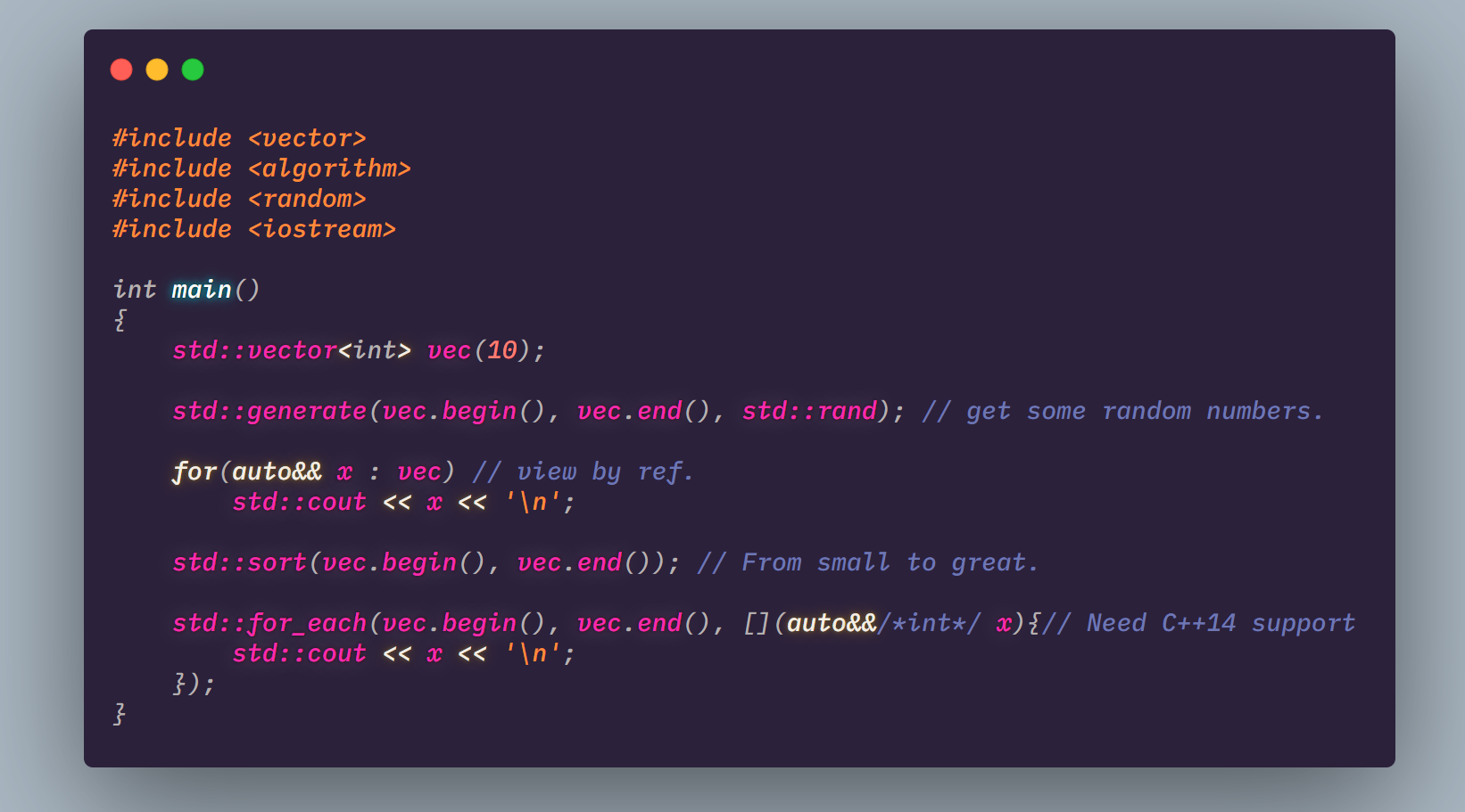
Algorithms —— An iterator view
vec.begin()
T
T
T
T
T
T
T
T
T
T
vec.end()
vec.begin()+3
No value here, just a dummy iterator marking the end.

Slide 21
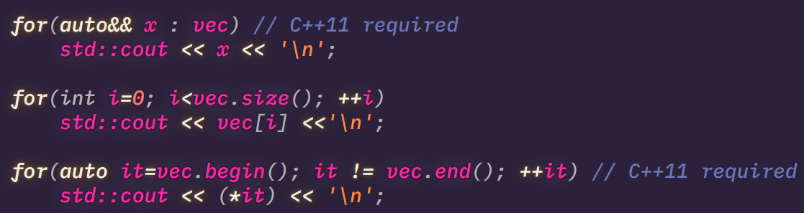
Iterate a container
Just the same(but more pythonic)

Slide 22
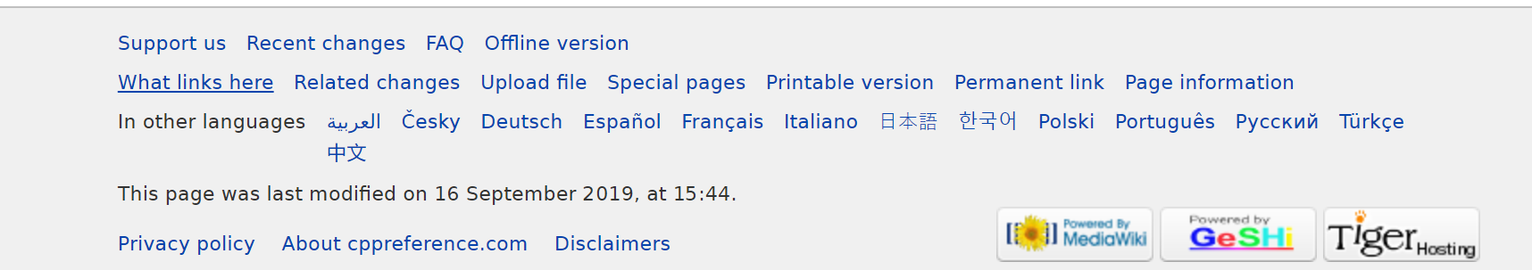
Finally
Look for what you need here(Not CSDN). (Always ref)
https://en.cppreference.com/w/

Slide 23
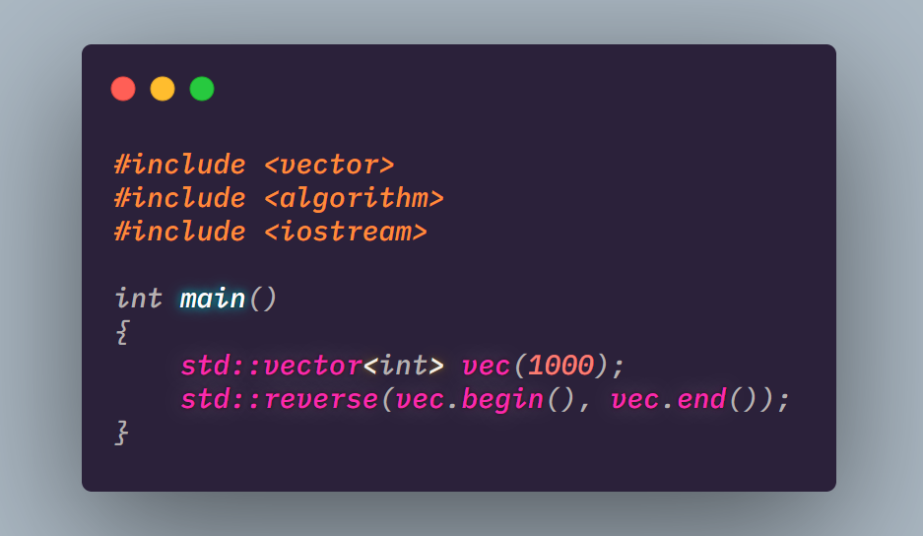
Quiz
给定一个长度1000的vector，请将其翻转。

Slide 24
Git & GitHub
/04

Slide 25
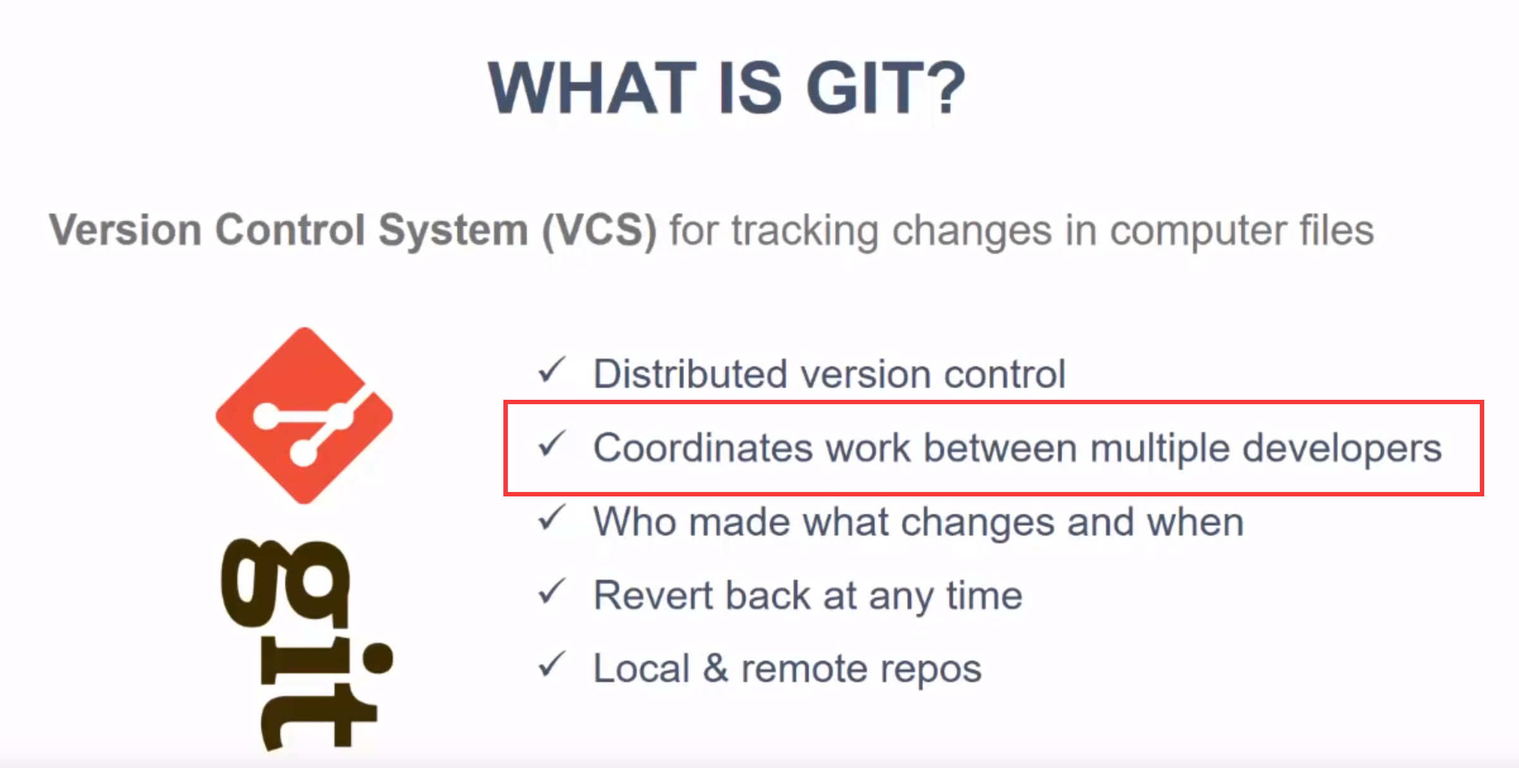
Git
https://www.youtube.com/watch?v=SWYqp7iY_Tc
https://product.hubspot.com/blog/git-and-github-tutorial-for-beginners

Slide 26
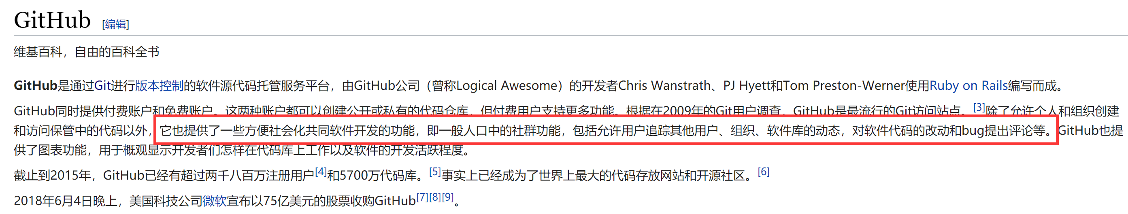
GitHub

Slide 27
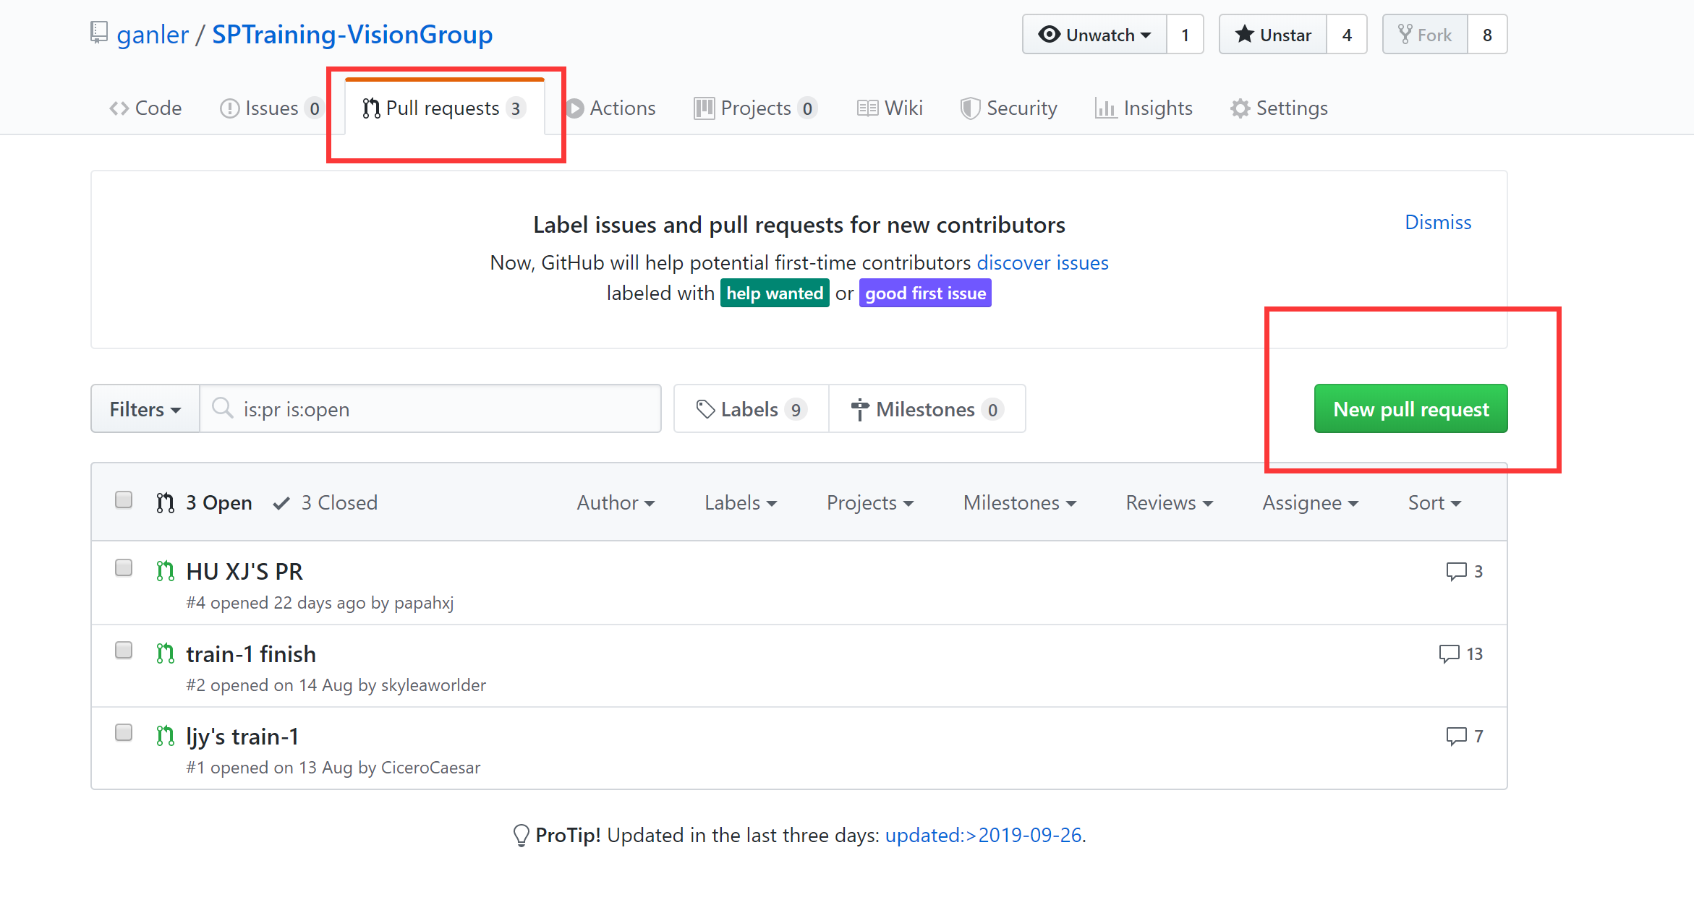
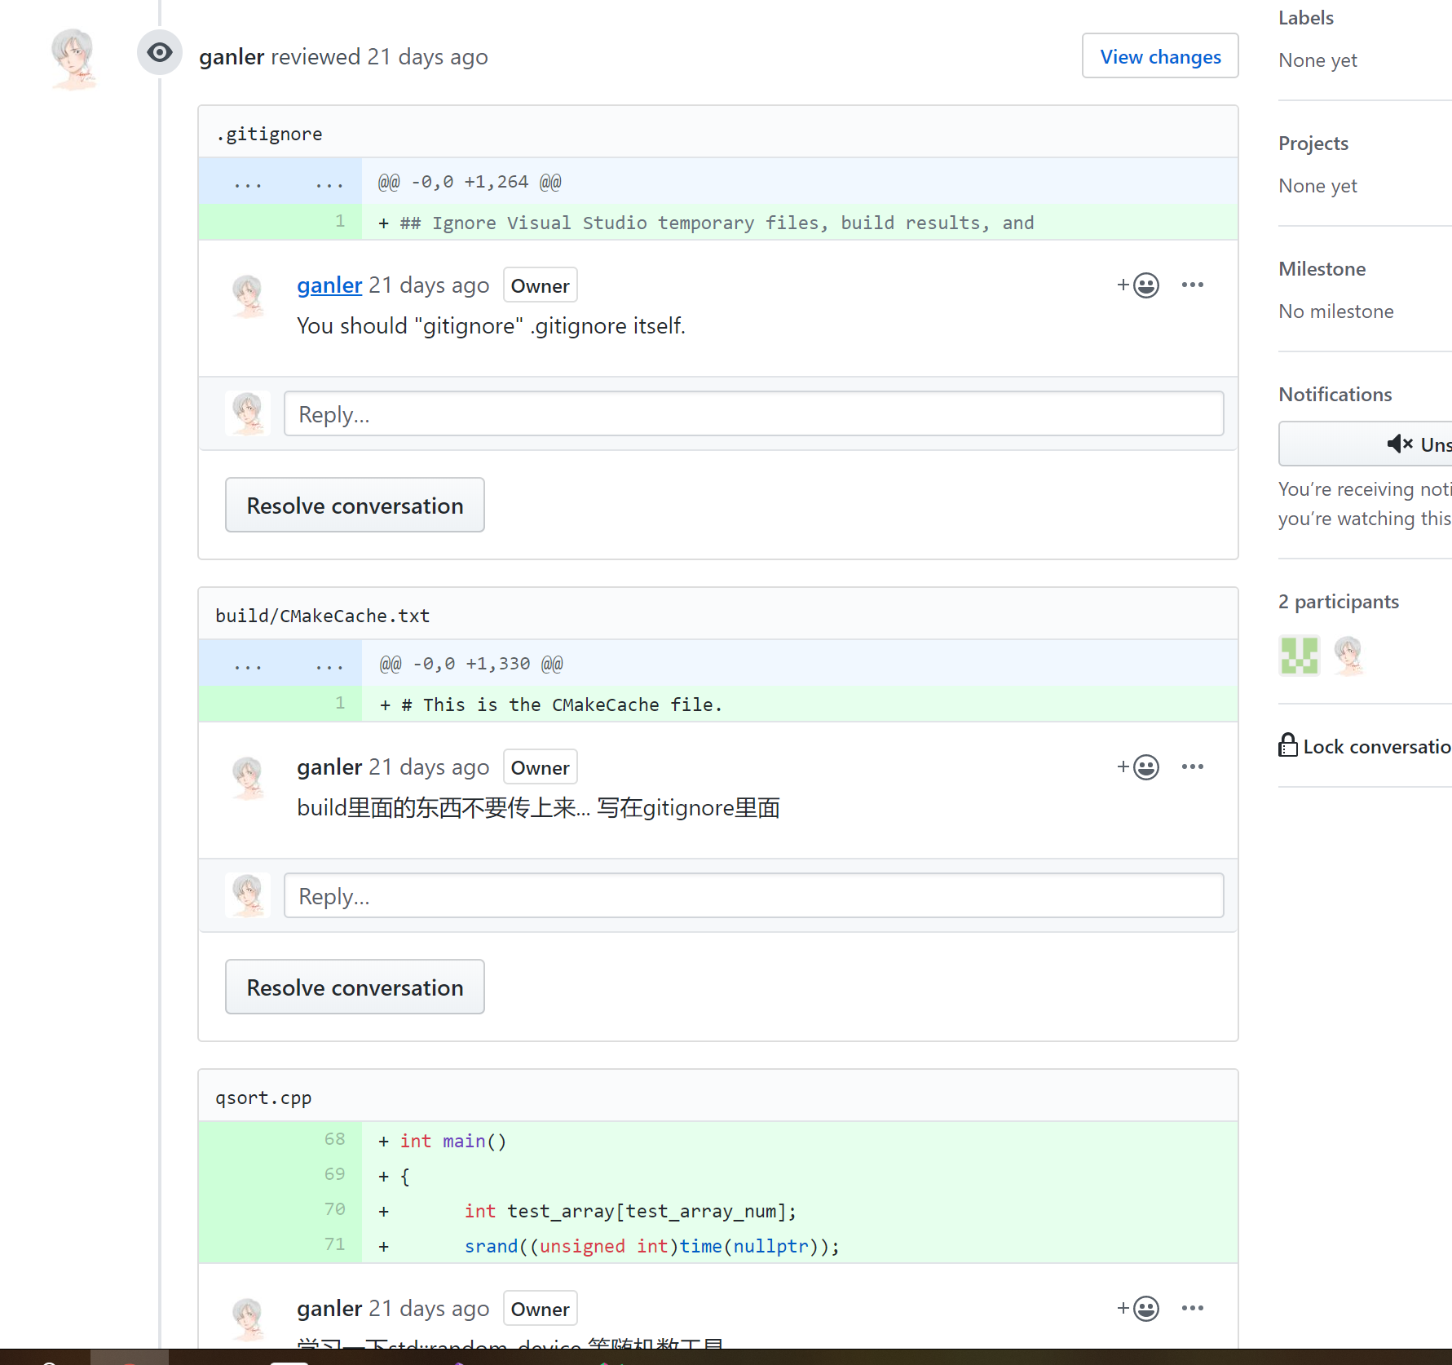
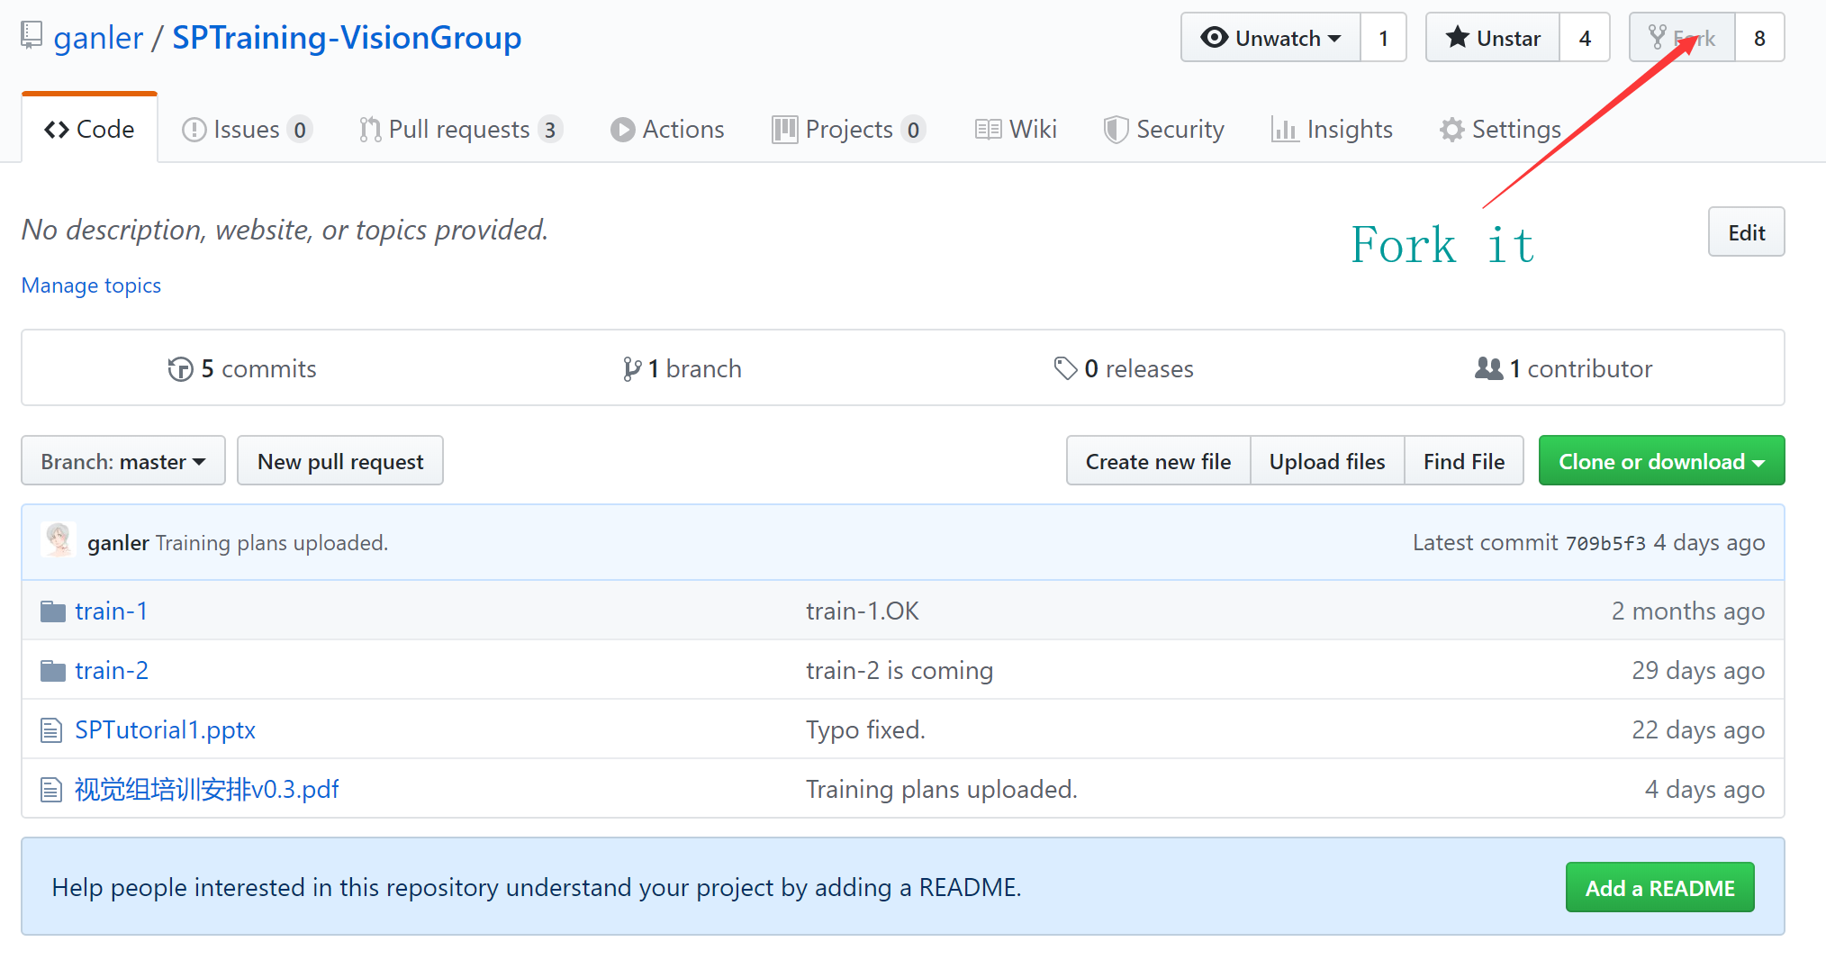
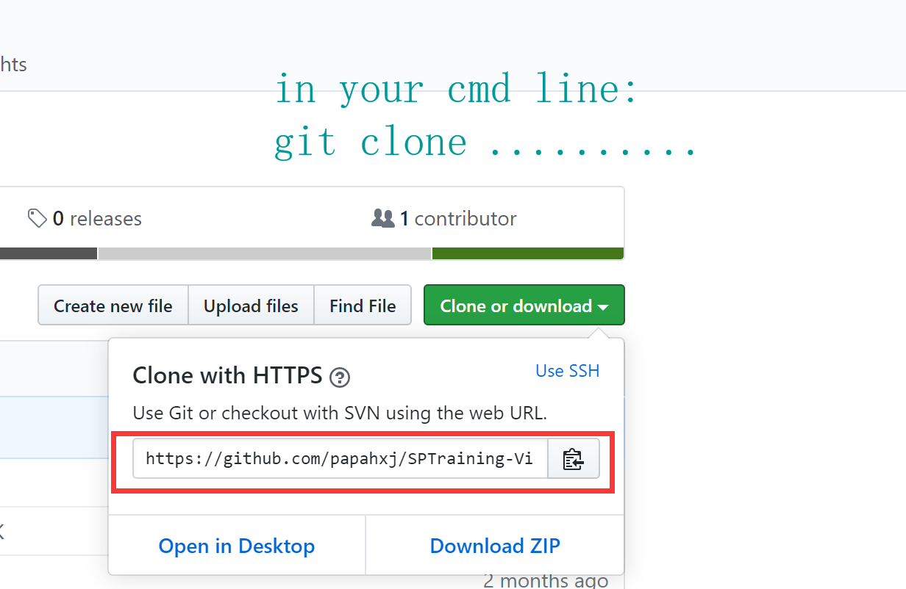
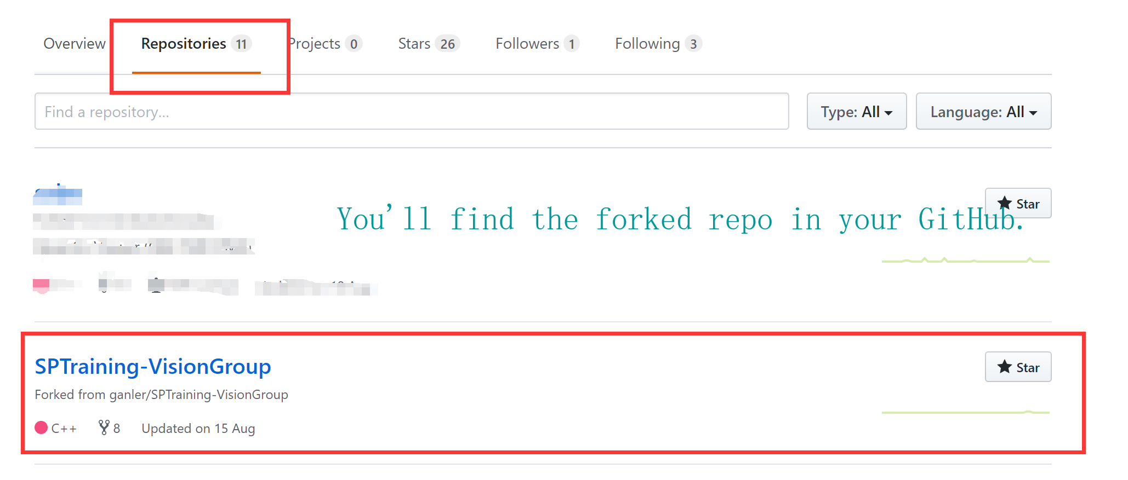
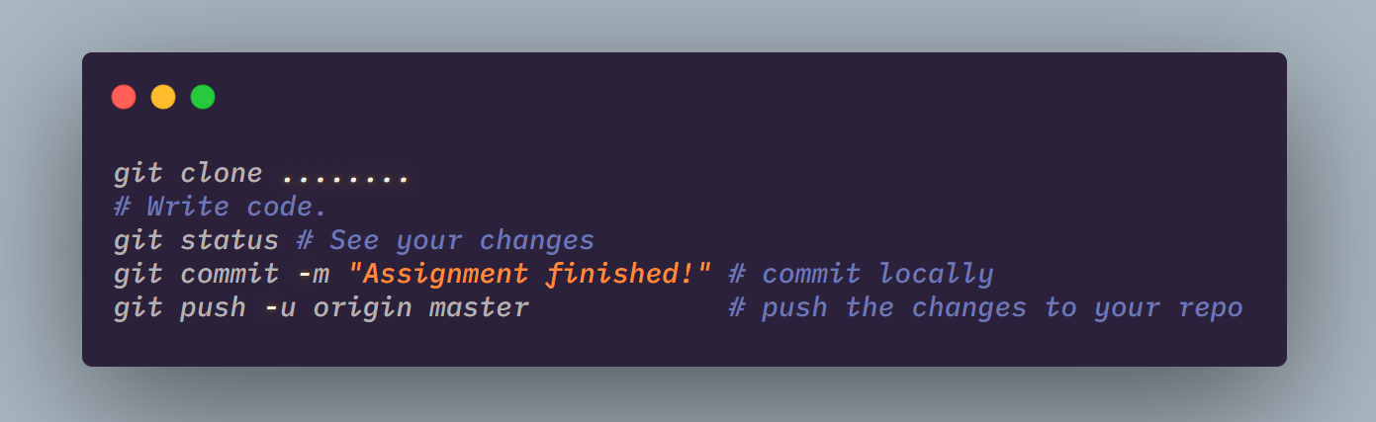
What you need to do
Ubuntu: sudo apt-get install git
Associate your local git with your remote GitHub account.
Fork this repo: https://github.com/ganler/SPTraining-VisionGroup (I’ll appreciate it if you star my repos.
Git clone the forked repo
Write your assignment code in this repo
Commit and push it to original master
Pull request and I’ll do code review 4 you

Slide 28
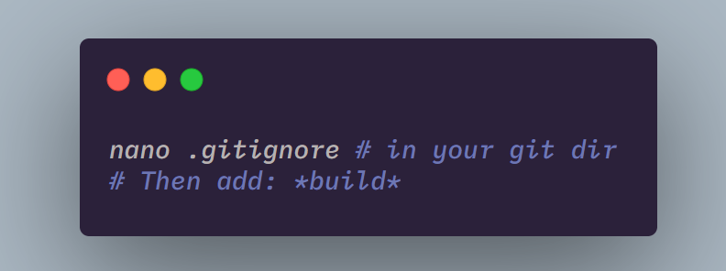
Attention
Do not push things in `build` to ur repo by using .gitignore

Slide 29
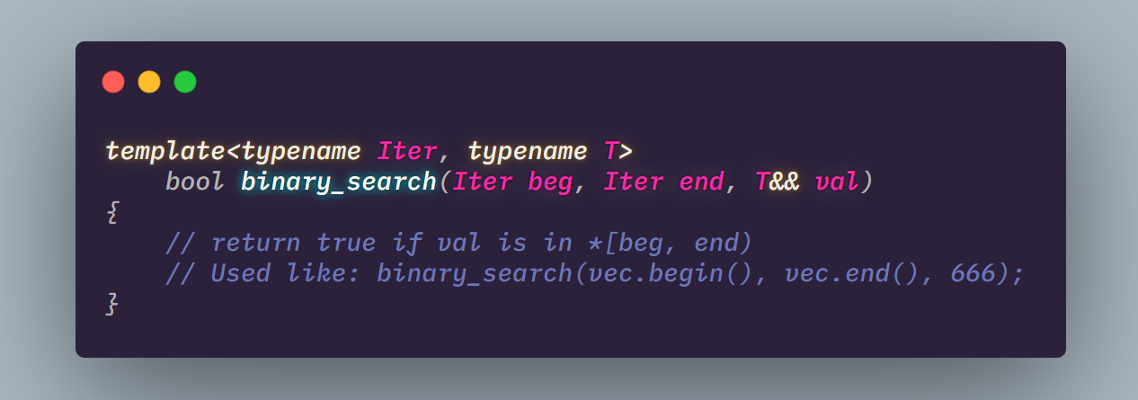
ASSIGNMENTS
Compile Facebook folly(https://github.com/facebook/folly) from source and record your shell codes.
Use cv::VideoCapture(二值化之后) in OpenCV to read a video.
Finish LeetCode~[189, 268] using STL.
Implement binary search with API like
DDL
2019/10/7
Notes:
iSlide，让PPT设计简单起来！
iSlide, Make PowerPoint Design Simple!

Slide 30
Further Reading
http://assets.hkoi.org/training2017/cppstl.pdf
YOUTUBE: THECHERNOPROJECT

Slide 31
std::quick_exit(0);
Notes:
iSlide，让PPT设计简单起来！
iSlide, Make PowerPoint Design Simple!

